Slide 1
Determinants of rates of serious hypoglycaemic events in type 1 diabetes
Paul McKeigue
Institute of Genetics and Molecular Medicine, University of Edinburgh
Acknowledgements: Anita Jeyam, Stuart McGurnaghan, Helen Colhoun, SDRNT1BIO investigators
22 September 2020

Slide 2
Scottish Diabetes Research Network Type 1 Bioresource
6076 people clinically diagnosed as type 1 diabetes followed for an average of 5.2 years.
C-peptide and autoantibodies measured in untimed blood sample at baseline
Follow-up through electronic health records: clinic measurements including HbA1c and body mass index, hospital admissions, retinopathy screening records
203 individuals with C-peptide > 600 pmol/l who were negative for all three autoantibodies were classified as “possible type 2” and excluded from this analysis.

Slide 3
Distribution of age at onset and duration at baseline
 | Duration | 0 to <5 | 5 to <15 | 15 to <25 | 25 to <35 | 35 -
Age at onset
0 to <15 |  | 13 | 352 | 537 | 524 | 595
15 to <25 |  | 167 | 330 | 351 | 360 | 287
25 to <35 |  | 145 | 310 | 335 | 253 | 124
35 - |  | 237 | 409 | 271 | 107 | 25

Slide 4
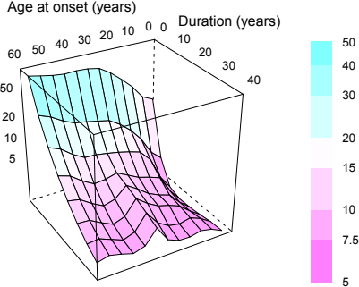
Geometric mean C-peptide by age at onset and duration
lattice

Slide 5
Self-reported unawareness of hypoglycemia
 | Odds ratio (95% CI) | p-value
Sex (female) | 1.28 (1.14, 1.45) | 6 × 10⁻⁵
Age at onset (years) | 1.00 (1.00, 1.01) | 0.2
Duration (years) | 1.02 (1.01, 1.02) | 8 × 10⁻¹¹
BMI (kg/m2) | 0.97 (0.96, 0.99) | 4 × 10⁻⁵
C-peptide 5 to < 30 | 0.92 (0.76, 1.11) | 0.4
C-bpeptide 30 to < 200 | 0.67 (0.54, 0.82) | 1 × 10⁻⁴
C-peptide >= 200 | 0.79 (0.62, 1.00) | 0.05

Slide 6
Self-report of hypoglycemic episode requiring help in last year
 | Odds ratio (95% CI) | p-value
Sex (female) | 0.95 (0.84, 1.07) | 0.4
Age at onset (years) | 0.99 (0.98, 0.99) | 3 × 10⁻⁵
Duration (years) | 1.01 (1.01, 1.02) | 3 × 10⁻⁶
BMI (kg/m2) | 0.96 (0.95, 0.98) | 1 × 10⁻⁷
HbA1c (mmol/mol) | 1.00 (1.00, 1.01) | 0.1
C-peptide 5 to < 30 | 0.73 (0.60, 0.89) | 0.001
C-peptide 30 to < 200 | 0.56 (0.46, 0.69) | 6 × 10⁻⁸
C-peptide >= 200 | 0.47 (0.36, 0.61) | 2 × 10⁻⁸

Slide 7
At least 1 hypoglycemic admission during follow-up
 | Odds ratio | p-value
Intercept | 0.03 | 2e-09
Gender | 0.71 | 0.009
Age at diagnosis | 1.02 | 7e-06
Duration (years) | 1.03 | 4e-10
BMI (kg m2) | 0.95 | 2e-04
HbA1c (mmol/mol) | 1.02 | 2e-06
C-peptide 5 to <30 | 0.71 | 0.1
C-peptide 30 to <200 | 0.56 | 0.01
C-peptide 200- | 0.52 | 0.02

Slide 8
Incident retinopathy during follow-up
 | Odds ratio (95% CI) | p-value
Sex (female) | 0.73 (0.61, 0.89) | 0.001
Age at onset (years) | 0.99 (0.98, 0.99) | 4 × 10⁻⁴
Duration (years) | 1.01 (1.01, 1.02) | 0.002
C-peptide 5 to < 30 | 0.91 (0.69, 1.21) | 0.5
C-peptide 30 to < 200 | 0.66 (0.50, 0.89) | 0.005
C-peptide >= 200 | 0.51 (0.35, 0.74) | 3 × 10⁻⁴

Slide 9
Modelling repeated events
Hypoglycaemic events occur repeatedly within each patient
Ignoring repeat events wastes information .
To model time-updated covariates, data must be split into person-time intervals
Hazard rates vary between individuals
Pooling person-time intervals from individuals with different hazard rates gives a distribution of counts of events that is overdispersed: variance > mean
Numbers of events in each person-time interval are usually small with many zero values
cannot be approximated by a Gaussian (normal) distribution

Slide 10
Standard modelling approach: negative binomial regression
Negative binomial distribution is a convenient way to model an overdispersed distribution of counts of events:
dispersion parameter can be estimated from the data
Limitations of negative binomial model:
ignores information about which person-time intervals are repeat observations on the same individuals.
assumes that dispersion parameter is constant across person-time intervals given covariates (Luo and Qu, 2013)
regression coefficients are not interpretable as log rate ratios
Simulation studies of repeat observations on same individuals show that it gives seriously misleading results

Slide 11
Mixed models for repeated observations on the same individuals
To model repeat observations of a continuous variable on the same individuals, we need to specify the variation between individuals as random effects.
Effects of covariates in a regression model are fixed effects
A mixed model has fixed effects for the covariates, random effects for individuals.
For counts of events (Poisson likelihood), we have to specify a generalized linear mixed model.
Model fitting requires Bayesian methods (implemented in Stan) but classical maximum likelihoods and p-values can be obtained from the posterior (divide by the prior to get the likelihood)

Slide 12
Rate of hospital admissions for hypoglycemia during follow-up
 | Odds ratio (95% CI) | p-value
Sex (female) | 0.67 (0.47, 0.96) | 0.03
Age at onset (years) | 1.03 (1.02, 1.05) | 4 × 10⁻⁶
Duration (years) | 1.05 (1.03, 1.07) | 2 × 10⁻¹⁰
BMI (kg/m2) | 0.90 (0.87, 0.93) | 7 × 10⁻¹¹
HbA1c (mmol/mol) | 0.98 (0.97, 0.99) | 1 × 10⁻⁸
C-peptide 5 to < 30 | 0.56 (0.30, 1.02) | 0.06
C-peptide 30 to < 200 | 0.52 (0.29, 0.93) | 0.03
C-peptide >= 200 | 0.35 (0.16, 0.76) | 0.008

Slide 13
Rate of hospital admissions for ketoacidosis during follow-up
 | Odds ratio (95% CI) | p-value
Sex (female) | 1.38 (1.11, 1.71) | 0.004
Age at onset (years) | 1.00 (0.99, 1.01) | 0.7
Duration (years) | 0.98 (0.97, 0.99) | 8 × 10⁻⁵
BMI (kg/m2) | 0.90 (0.88, 0.91) | 6 × 10⁻²⁸
HbA1c (mmol/mol) | 1.01 (1.01, 1.02) | 2 × 10⁻¹⁸
C-peptide 5 to < 30 | 0.94 (0.63, 1.39) | 0.7
C-peptide 30 to < 200 | 0.95 (0.68, 1.34) | 0.8
C-peptide >= 200 | 0.44 (0.29, 0.67) | 1 × 10⁻⁴

Slide 14
Modelling the form of the relationship of each outcome to C-peptide
Is there a threshold level of C-peptide for protection against on adverse outcomes?
Results of standard approach – multivariable fractional polynomials (Royston and Altman 1994) – are dependent on arbitrary p-value thresholds for which terms to retain
Bayesian approach – mixture of fractional polynomials – averages over a finite mixture of generalized linear models encoding different Box-Cox power transforms of the covariate.
computationally intensive with when applied to mixed models

Slide 15
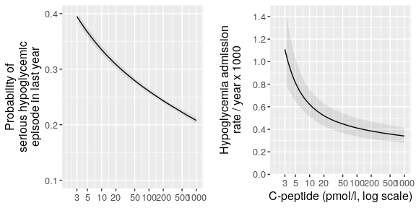
Form of relation of hypoglycemic episodes to C-peptide level

Slide 16
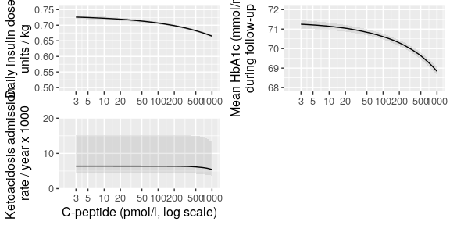
Form of relation of other outcomes to baseline C-peptide level

Slide 17
Risk factors for serious hypoglycemia
Baseline covariates associated with increased risk of hypoglycemia at follow-up:
Later age at diagnosis
Longer duration
Higher HbA1c
Lower body mass index
Absent / low residual C-peptide secretion

Slide 18
Could misclassification of high C-peptide secretion as low explain these results?
Non-fasting untimed serum C-peptide levels in people with type 1 diabetes have been shown to be highly correlated with C-peptide levels after a mixed meal (Hope 2016).
Restricting to those with glucose levels of at least 8 mmol/l in the same sample as that used for C-peptide measurement did not weaken the effect of low levels of C-peptide.
Misclassication of people with high levels as having low levels would affect all outcomes equally – but it is only for hypoglycemia and retinopathy that protective effects at low levels of C-peptide are detectable.

Slide 19
Comparison with other studies
DCCT follow-up of 412 individuals in the intensive treatment arm: inverse relationship of C-peptide with serious hypoglycemia detected only above levels of ~130 pmol/l (Lachin 2014), no association in follow-up of 98 individuals (Henriksen 2016)
Marren (2019): study of 157 individual using Exeter assay, self-reported hypoglycemia levels one-third lower in participants with C-peptide > 20 pmol/l

Slide 20
Interventions that restore or preserve residual beta cell function
Islet cell transplants: profound reduction of severe hypoglycemic events at 2-3 years post-transplant despite only low levels of C-peptide secretion and slight reductions in insulin dose and HbA1c levels (Vantyghem 2010, Brooks 2015).
TIDAL trial of alefacept therapy: continuous relationship between hypoglycaemia and C-peptide levels with no threshold, whether or not such levels were achieved by treatment (Pinckney 2016).
Decrease in intraislet insulin is a signal for the glucagon response to hypoglycemia (Raju 2005): minimal residual capacity for C-peptide secretion might be enough to maintain this signalling,

Slide 21
Clinical implications
Even very low levels of residual C-peptide secretion (< 30 pmol/l) are enough to reduce the rate of serious hypoglycemic episodes by about 40%.
supports use of C-peptide levels as a surrogate end-point in trials of therapy to slow / reverse progression of Type 1 diabetes
assessment of clinical benefit should be based not on insulin dose requirement or glycaemic control but on serious hypoglycaemic events and retinopathy.

